Slide 1


theGivingTree
Give smarter
Problem: Donators need an easy way to donate to the causes they care about effectively and track their donations. Organizations need a consistent stream of donations that enable them to plan and budget effectively long-term.
Solution: An app that takes the guesswork out of donating by automatically identifying high-impact nonprofits that users can donate to, letting them set up recurring donations, and managing donations long-term.

Slide 2




Market Research
Givelify and Donorbox are the main competitors.
How their solutions differ?
Individuals can start their own donation drives
Mainly for church/ministry organizations
Ask for names of specific organizations you want to donate to
What works?
The UI/UX is simple and they allow for filtering
What doesn’t work?
Overwhelming focus on religion
App focus is on helping organizations organize donations
What makes us unique?
We allow users to choose a cause as opposed to an organization to donate to, saving users time and effort from researching
Notes:
Givelify: heavy emphasis on religious causes, has a financial tracking component. We like the financial tracking, but want to focus more
Donorbox: focus is on how to invite and encourage donors; aimed at individuals/organizations starting donations, not donors, which is what we do
Fundly: website only; also aimed at individuals/organizations starting donations (has functionality like Facebook donation integration), not donators, which is what we do.
broadly on social good, not religion.
Onecause: includes auctions, event planning

Slide 3
Tasks
Simple
Medium
Complex
Donate to a cause effectively without having to do research on organizations
Set up recurring donations for different causes or organizations
See the organizations and amount you’ve donated to them long-term and retrieve your tax-forms
Notes:
Simple
Donate to a cause effectively without having to do research on organizations
Medium
Set up recurring donations for different causes or organizations
Complex
Add your charity
See the organizations and amount you’ve donated to them long-term and retrieve your tax-forms
Request donations for specific items for short-term causes (ex: school supply donations at the start of school,water for flood relief, etc…)

Slide 4
Values in Design
Conflicting Values
Equity:
Financial equity
Wealth redistribution
Sharing knowledge
Efficiency:
Minimizing complexity of donating
Suggests charities that are effectively using donations or are in need of money
Education
Learning financial benefits of donating
Learning about which organizations are legitimate
Finding balance between wealth redistribution and white-savior complex
We addressed this issue by incorporating the task to provide tax forms, a concept typically only familiar for wealthy communities.
Taking into consideration that all non-profit organizations must have circulating resources and funding
Notes:
Conflicting Values:
Our values surround systemic equity and ensuring that different marginalized communities are receiving support, which can be progressed through financial equity. However, this can create a dynamic in which privileged individuals are fixing the problems of marginalized communities, in tern reinforcing a hierarchy of wealth, privilege, and inherently white supremacy.

Slide 5
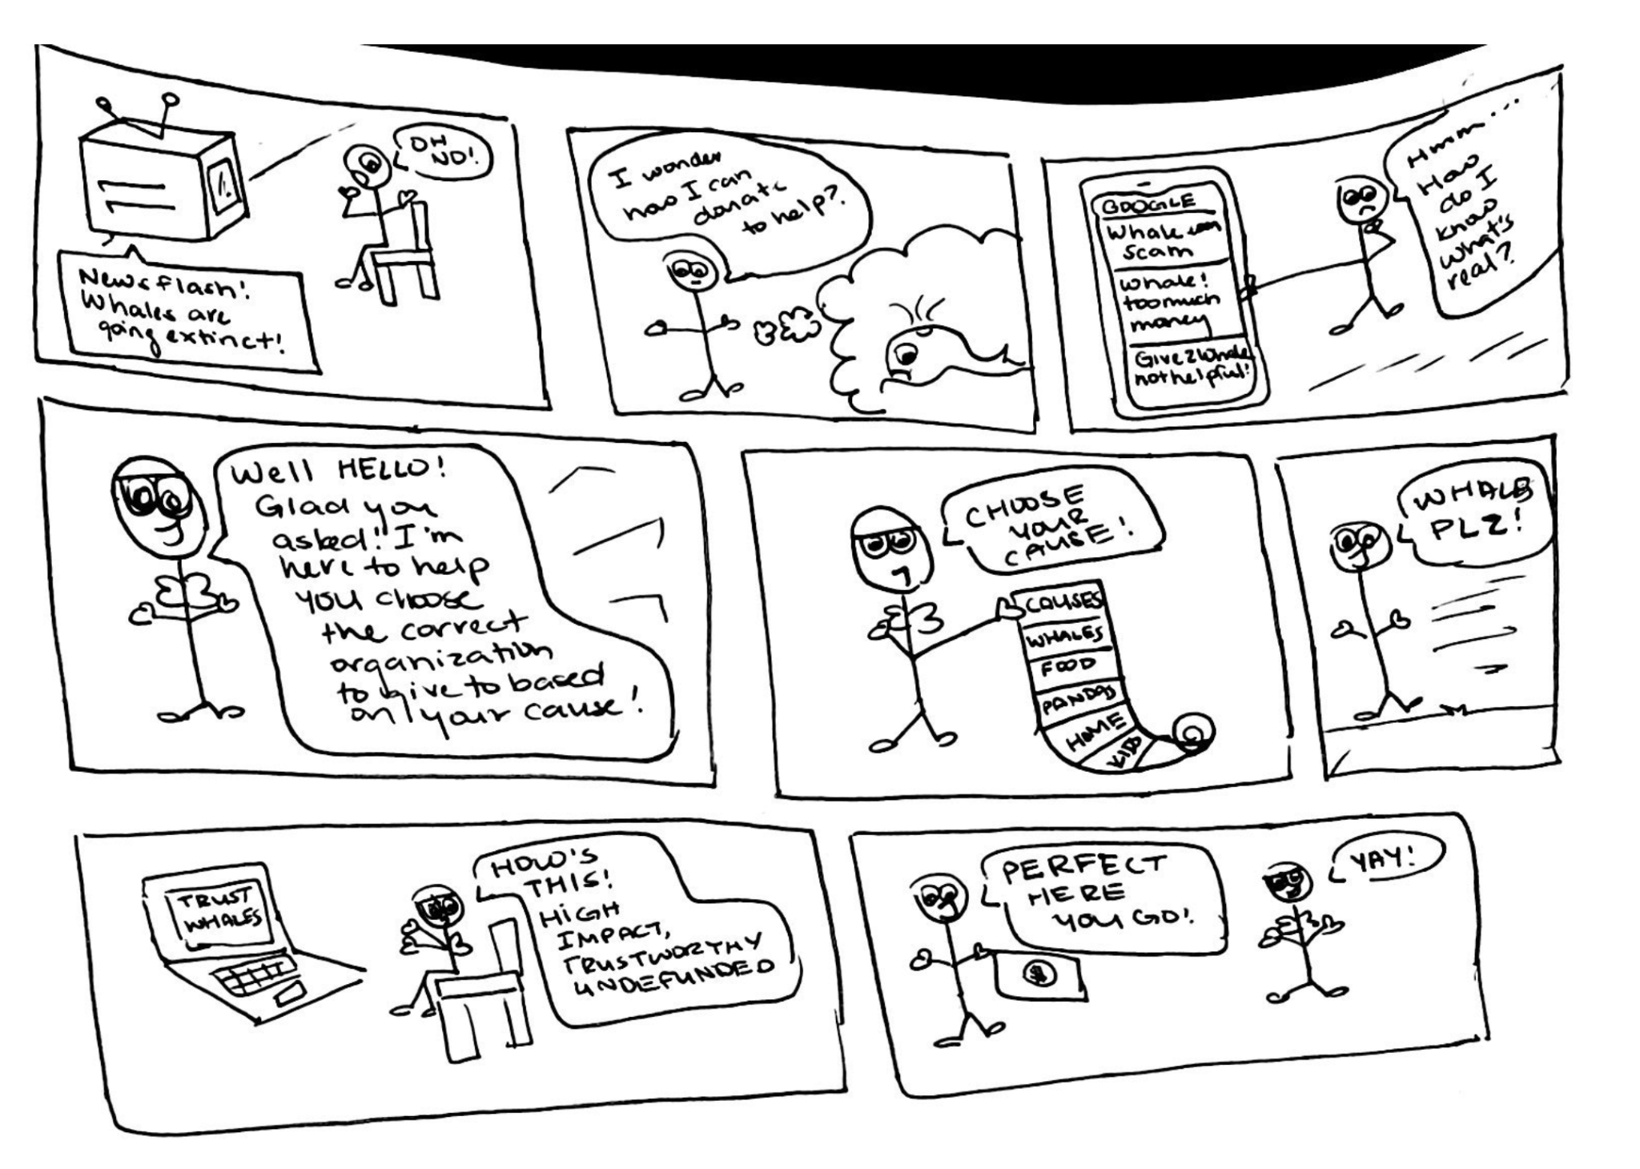
Video Storyboards
Problem: People understand the cause they want to support but do not know which organization
Simple Task: Donate to a cause effectively without having to do research on organizations.

Slide 6
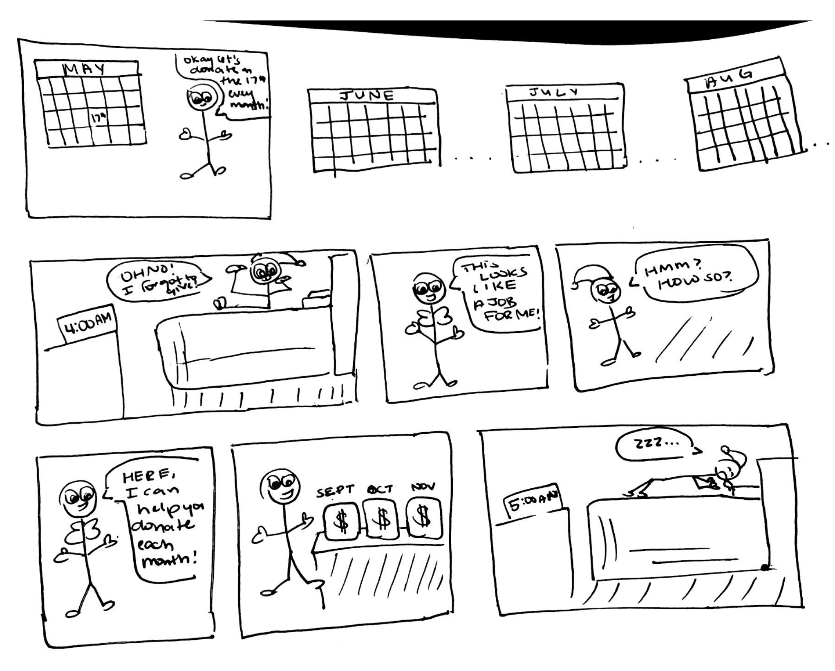
Video Storyboards
Problem:
Donors: Want to donate regularly and as much as they can but do not remember or cannot afford a lump sum
Organizations: Need a more consistent stream of income for budgeting
Moderate Task: Set up recurring donations for different causes or organizations.

Slide 7
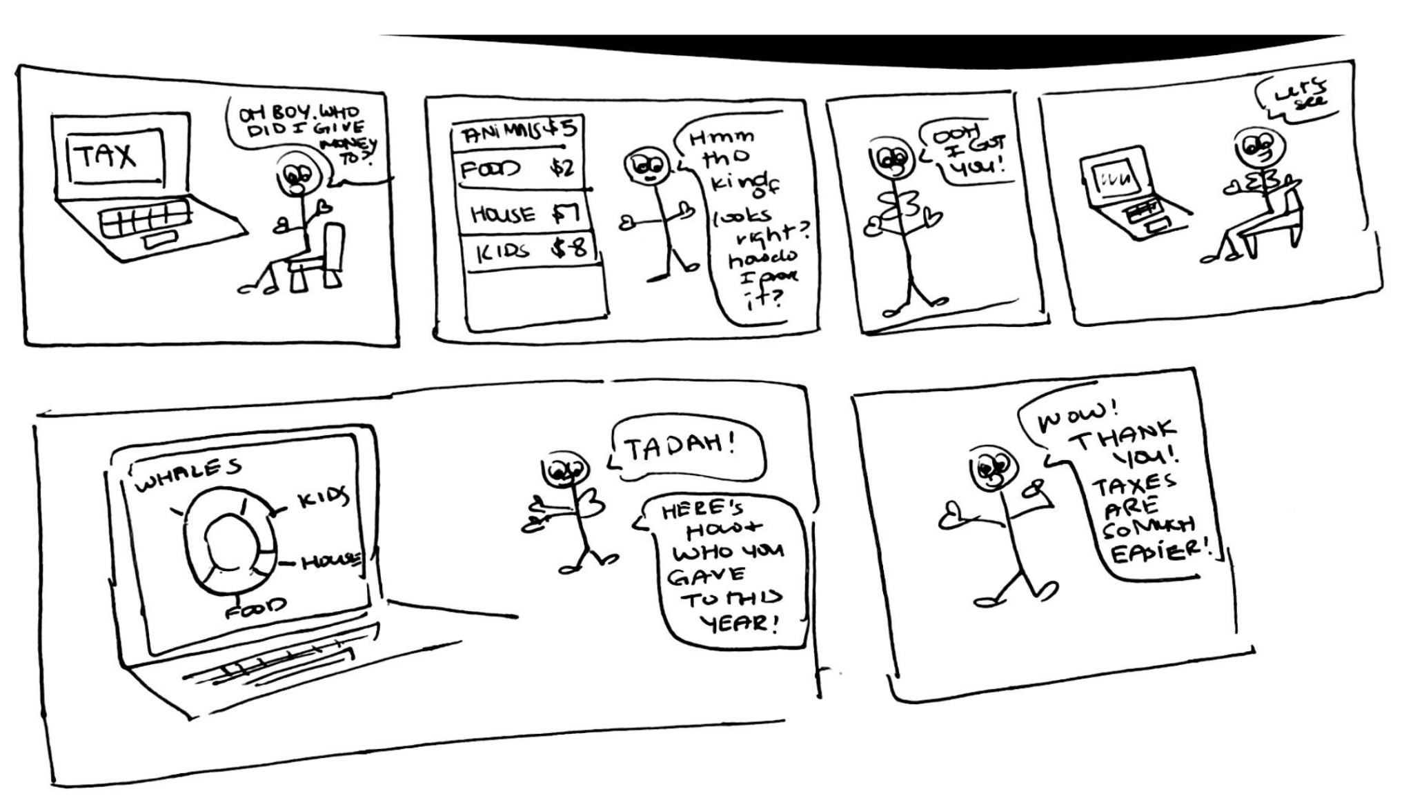
Video Storyboards
Problem:
Remembering where you donated to for financial purposes is hard leveraging them is rare to do when you are not the financial elite
Complex Task: See the organizations and amount you’ve donated to them long-term and retrieve your tax-forms

